Slide 1
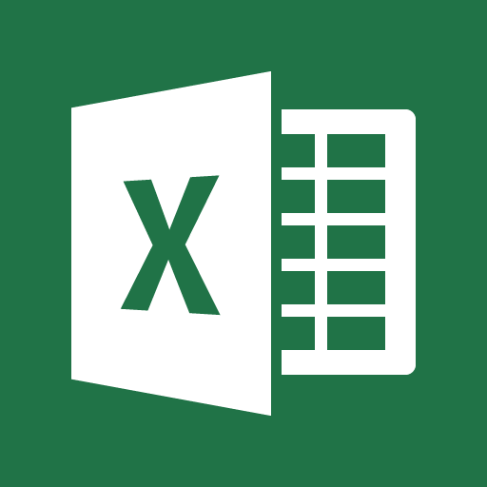
MICROSOFT EXCEL
By –
Dr. Nishtha Jain

Slide 2

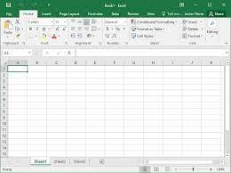
What is MS-Excel?
Microsoft had developed this spreadsheet application.
Word, PowerPoint, Access, Outlook, OneNote, and other
Microsoft programs are included in the MS-Office Suite.
The data in Excel is arranged into columns and rows, and can be used to execute mathematical operations, create beautiful and logical charts and do much more.
Excel is compatible with all Operating Systems - Windows, Mac OS X, Android, and iOS.
It has amazing features that anyone can learn to use, contrary to the belief that it is used only to process complex data.

Slide 3
Why do we use Excel?
Data Entry and Storage - Excel works best for organizing and storing data in a tabular format.
Although the number of rows & columns is limited to -
1,048,576 rows & 16,384 columns.

Slide 4
Why do we use Excel?
Computation/Calculations – Approximately 450 built-in functions (and formulas) in MS Excel.
Some of the most common operations/functions are mathematical, statistical, logical, string, and DateTime functions.
Additionally, Excel contains VBA and Macros tools that let us create our own unique features to carry out certain data operations.

Slide 5
Why do we use Excel?
Data Analysis and Interpretation – Numerous features for data analysis that help in making decisions and deriving valuable data-driven insights.
To summarize and calculate data, pivot table can be created that emphasizes the most essential components of large datasets.
Tables can be operated efficiently by sorting, filtering, and conditional formatting.
These help us in keeping a detailed and accurate data analysis report.

Slide 6
Why do we use Excel?
Accounting and budgeting - Keeping an up-to-date and organized track of staff or clients records with a variety of budgeting and accounting templates that make record-keeping simpler.
Various calculations can be performed, that may involve simple to complex formulas.
Also information can be extracted from Excel and shared it with others as and when required.

Slide 7
Why do we use Excel?
Reporting and Visualization - The analysis is just not complete without displaying the data in the form of graphs, charts, or other visuals.
The different built-in charts in MS-Excel are a better way to show the intended outcome.
For ex - line chart, bar chart, pie chart, etc.
Just pick a template and the input data in order to create charts.
Customized charts can also be created.
Moreover, multiple charts can be compiled into a dashboard.

Slide 8
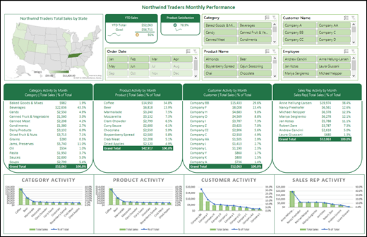
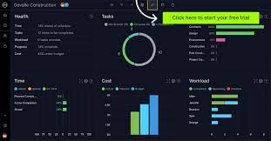
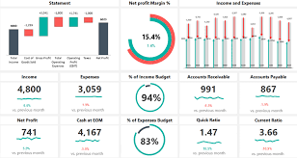

Slide 9
Use cases of excel in companies
Finance and Accounting – Perform tasks and operations like budgeting, generating financial statements, building balance sheets, predictions, expenditure tracking, financial reports, loan calculators, etc.
- You can easily import and export banking and financial data to and from other accounting software platforms.
- A rich user experience of the same data can be produced by creating charts and graphs from the spreadsheet data.
- Several spreadsheet templates are available in Excel to make all those procedures simpler.

Slide 10
Use cases of excel in companies
Human Resource – HR’s main objective is to maximize productivity while maintaining the budget and providing benefit to the company as a whole.
Work plans, staffing, and employee compensation are a few.
Human Resource experts use Excel to analyse a huge spreadsheet of employee records to see the expenses, and to plan and control them effectively.

Slide 11
Use cases of excel in companies
Marketing and Project Management - Using spreadsheets to track customer and sales targets can help you manage and plan future marketing strategies based on past performances.
- Marketing and product managers rely on their finance departments, when it comes to financial research.

Slide 12
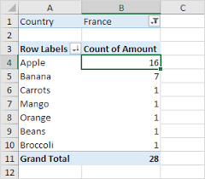
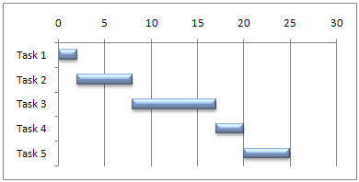
A pivot table can be used to summarise customer and sales data with a simple drag-and-drop.
You can build a Gantt chart, that plots tasks depending on their duration, start and end time, and dates.
To keep track of a short list of expenditures as against a list of incomes, creating a budget is very simple.
Although Excel can also help you generate more elaborate budgets if needed.

Slide 13
Basic tasks
Here are some basic tasks that can be easily performed in Excel :-
Using different workbook templates
Enter and edit data
Create workbooks
Save the workbooks
Download the Excel file in different formats

Slide 14
Apply border to cells and remove them
Font customization
Fill color
Switch to different data formats
Use formulas and functions for calculations and analysis
Sorting and Filtering data
Using the Quick Analysis
Printing the workbook

